Slide 1
Live session 7 manova AND lda
Experimental Statistics II

Slide 2
LETS TAKE A STEP BACK
&
THINK BIG PICTURE

Slide 3
Multivariate Analysis Basic Topics
Everything we’ve done so far
Single, continuous response variable
Multiple Regression/Two Way ANOVA
Time Series / Repeated Measures
Multivariate Analysis can be extended to handle all of those but for multiple, continuous response variables
Take into account that response variables are correlated with each other
Example: Suppose I have a study population and want to compare (Men vs Women) on not just height, but also on weight, age, bmi, heart rate, time on 1mile run
Clearly these guys can some what depend on one another, bmi is probably negatively associated with 1mile run times. Height and weight are somewhat positively correlated
Data Reduction Technique
Our brains can’t comprehend high number of dimensions so maybe we can reduce a large set of response variables to a more controllable number to wrap our heads around
Common theme when reading about multivariate techniques
Issues with interpretation
New variables can be used as predictors

Slide 4
Multivariate Analysis can be extended to handle all of those but for multiple, continuous response variables
What does multivariate get you?
Its all about type-I error control and power
Type-I error: Probability(reject the Null when the Null is true) aka False Positive
Power: Probability(reject the Null when the Null is FALSE) aka reject when you should reject
Analyzing multiple response variables one at a time is another way of multiple testing, just like in our one variable analysis when we do different types of comparisons. We could do a single comparison but multiple times across different response variables.
The idea is that correlated data tend to yield similar results so when you commit a type-I error for variable 1 you are now setting yourself up for another type=I error for the correlated variable 2.
Also correlated variables are more consistent and its easier to identify scenarios that are not null and thus reject more often (increasing power)

Slide 5
Simple example
Suppose I had height (X1) and weight (X2) and I wanted to test if the mean height and weight was (68inches,150lbs)
Two options
One at a time testing
One sample t-test for height (X1)
One sample t-test for weight (X2)
Multivariate Analysis
Conduct a joint hypothesis that takes into account they are correlated

Slide 6
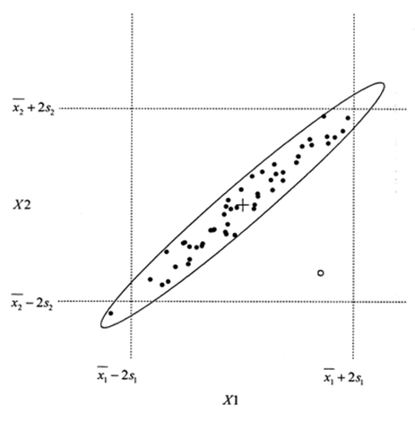
Graphical Difference One at a time vs Jointly
One at a time tests/confidence intervals can in a 2 dimensional graph can be viewed as a box

Slide 7
Graphical Difference One at a time vs Jointly
Multivariate tests/confidence intervals can be thought of as an ellipse

Slide 8
Example scenario for greater power
Suppose our null hypothesis for the mean of height and weight is given by the yellow dot
One at a time confidence intervals say for both variables we will not reject the null hypothesis
Joint confidence ellipse (taking into account correlation) says the hypothesized value is outside of the confidence ellipse indicating that we should reject the null.

Slide 9
Example scenario for controlling type I error
Suppose are null hypothesis for the mean of height and weight is given by the yellow dot
One at a time confidence intervals say for both variables we will reject the null
Joint confidence ellipse (taking into account correlation) says the hypothesized value is inside of the confidence ellipse indicating that we should fail to reject

Slide 10
Removing the Curtain
We’ve actually been conducting this type of testing already
Every time we conduct an overall F tests to test if there is at least one regression coefficient different from 0, test for an interaction or main effect in two way anova
Regression coefficients like the slope and the intercept in simple linear regression are actually mathematically correlated with each other unless the explanatory variables are standardized to have mean 0.
The overall F-tests conducts the multivariate approach to control for type-I error. Once it is rejected, that gives us the clear to do one at a time testing for each regression coefficient

Slide 11
The MANOVA analysis idea In terms of testing
We are just going to add a layer for MANOVA at the top
High Level Testing
F-test for finding if ANY differences exist
Low Level Testing
T-tests for finding which specific ones are different from each other

Slide 12
The MANOVA analysis idea In terms of testing
We are just going to add an extra layer at the top for MANOVA
High Level Testing
F-test for finding if ANY differences exist
Low Level Testing
T-tests for finding which specific ones are different from each other
Multivariate MANOVA tests
F-tests via Wilk’s Lamda, Pilai Trace, etc
F test to test if ANY differences exist across any of the multiple responses

Slide 13
MANOVA DERIVED F tests
Here is where all the different options come in
Wilks Lambda
Pillai’s Trace
Hotelling Lawley Trace
Roys Greatest Root
All different approaches of reducing a ratio of two covariance matrices down to a single value.
Note: The F-tests that SAS conducts are exact for large sample sizes. When sample sizes are small, SAS can do more exact versions but their accuracy depends on the situation.

Slide 14
Recap MANOVA
Just like ANOVA but with multiple responses
Univariate ANOVA
Continuous Response
1 categorical factor (with two or more levels)
Null: Response variable has the same mean for each factor level
Assumptions
Errors are Normal, Independent, Constant Variance
MANOVA
Multiple Continuous Responses
1 categorical factor (with two or more levels)
Null: Each response variable has the same mean for each factor level. (Response variables do not have to share the same mean that would make the method useless)
Assumptions
Errors are Multivariate Normal, Independent, Equal Covariance Matrices
Other needs: Sample size needs to be sufficient, samples within each factor level need to be larger than the number of levels. No outliers (both univariately and multivariately)
Remember for one variable we just have a variance to worry about, multiple variables we need a matrix (Covariance matrix) to book keep all the variances as well as each pair of covariances that measure how the variables depend on one another… how they move together.

Slide 15
AnalySis Plan for one way MANOVA
Identify the multiple responses and the single categorical factor
Plot DATA as much as you can, Two variable scatterplots, three variable 3d plots, etc. Assumption is the errors should be multivariate normal. So plots of the raw data pairwise, should have linear elliptical type relationships with possible different locations, but the shapes of the ellipses for each group should be the same (Equal covariance matrices).
Fit MANOVA along with univariate ANOVA models
Examine one by one the residuals and make sure that each individual is behaving like it should (constant variance, normality)
Some software have a test to test for equal covariance matrices between the groups, much like the F-test for equal variances in the two sample t-test problem (PROC DISCRIM)
Screen for outliers all throughout the processes above (both bullet points)
If everything looks good, exam the overall MANOVA F-tests
If not significant then stop and we are done (Fail to reject)
It is possible for some of the univariate analysis to have significant F-tests but we don’t care because the overall tests protects us from making a type-I error

Slide 16
Analysis Plan
If the overall F-tests is significant then the fun begins
Most straight forward thing to do is then to jump in and do one at a time analysis ANOVA F-tests and contrasts using our univariate approach we discussed in class
Penalize yourself for multiple tests
There is no set way to do this here. There are a lot of different approaches to doing this. Do what you think is reasonable.
The easiest way to do this in practice is to use Bonferrorni corrections as they are easiest to calculate by hand. (.05/total number of tests to correct for)
Some people may add up all the tests and do one big corrections, while others may do multiple testing corrections at different stages or by variable

Slide 17
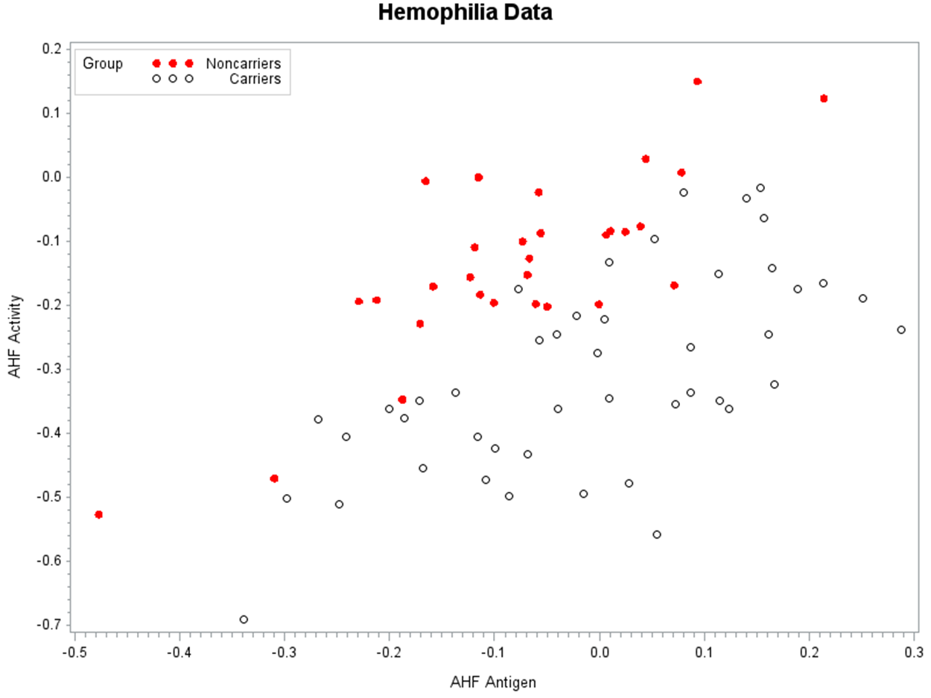
Hemophilia data
Two Response variables , 1 factor (2 levels)

Slide 18
Added difficulties
More than two levels it gets really busy
More than three response variables and we can’t even plot them together (Can’t see higher than 3 dimensions)
Again the idea is try to see if the multivariate normal assumptions with constant covariance matrix is appropriate. We should see linear relationships that follow ellipse patterns in 2d and ellipsoids in 3d
Any nonlinear type relationships, transform to linear, if not, maybe consider throwing out the variables in question
Proc DISCRIM provides an F-test for equal covariance matrices, however, you are stuck if this test is rejected as MANOVA assumes that they must be equal

Slide 19
Run the model
Run the MANOVA model along with univariate versions, output residuals to check assumptions
Proc GLM Data=Hemophil plot=diagnostics;
Class Group;
Model Activity Antigen = Group;
Output Out=Errs R=Eact Eant;
Means Group / CLM T Alpha=0.025;
Means Group / CLDIFF T Alpha=0.025;
Contrast 'Carrier vs Noncarrier' group 1-1;
Manova H=_All_ / PrintE PrintH Canonical;
ODS Output Cancoef=CanonicalCoefficients;
Run;
Quit;
Options: Doesn’t matter yet. We have to feel comfortable about the assumption

Slide 20
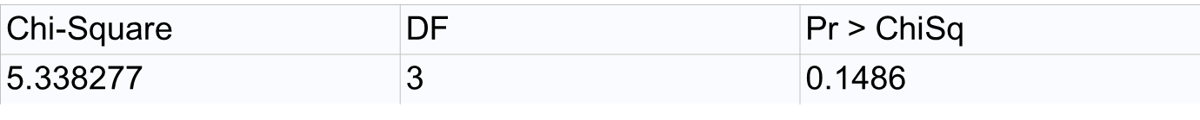
Final checks
Check residuals from the univariate analysis. Make necessary transformation for constant variance, outlier investigation, and normality
If you suspect unequal covariance matrices conduct the test using proc discrim:
proc discrim data=Hemophil pool=test;
class group;
var Activity Antigen;
run;

Slide 21
If everything checks out Conduct MANOVA F-tests
What are we testing for ? Null: The means for each response variable (activity and antigen) do not differ from the factor levels of interest (carrier ,noncarrier)
Note: This does not say that the mean values for activity must be the same for antigen.

Slide 22
Fail to Reject=Done Reject=Move On to univariate results
Run the MANOVA model along with univariate versions, output residuals to check assumptions
Proc GLM Data=Hemophil plot=diagnostics;
Class Group;
Model Activity Antigen = Group;
Output Out=Errs R=Eact Eant;
Means Group / CLM T Alpha=0.025;
Means Group / CLDIFF T Alpha=0.025;
Contrast 'Carrier vs Noncarrier' group 1-1;
Manova H=_All_ / PrintE PrintH Canonical;
ODS Output Cancoef=CanonicalCoefficients;
Run;
Quit;
Options:
Means option works like LSMEANS. CLDIFF conducts all pairwise differences, alpha is set to .05/2 to account for the fact we are running two tests one for each variable (Bonferroni)

Slide 23
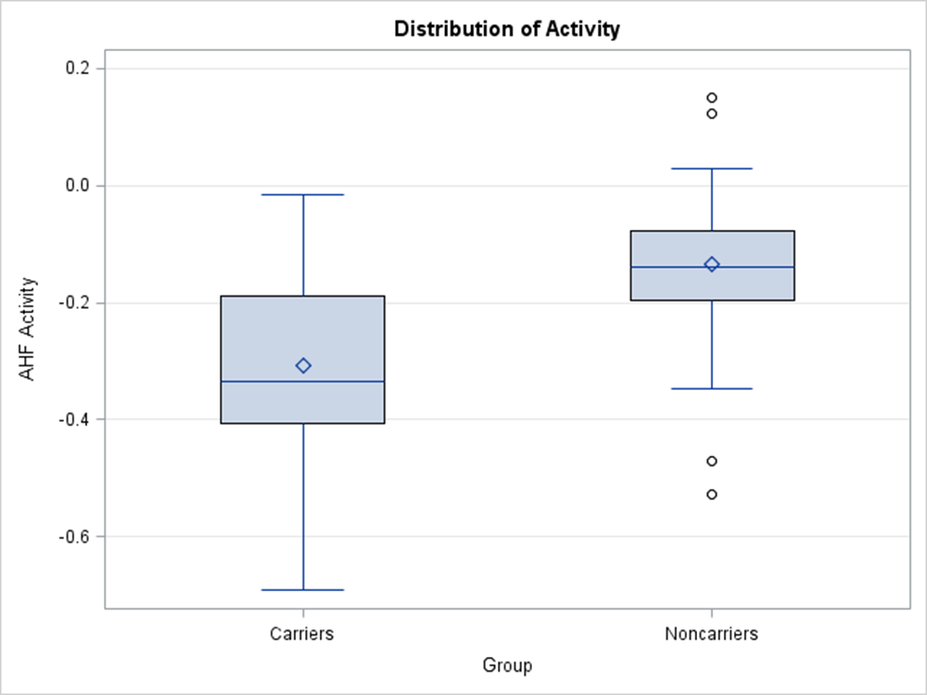
Activity Result

Slide 24
LDA
SAME Setup as MANOVA but with a different question
Two Goals
Prediction/Classification
Given a new observation (Activity and Antigen variable) can I predict if that individual is a Carrier or Noncarrier
Response variable is now the Factor levels
Understanding ( This was not a focus in the videos)
Is there a more simpler way to understand what variables contribute to the differences between Carrier or Noncarrier
Candis as well as lda can get you information to help answer this question

Slide 25
LDA (Data Reduction pov)
Given multiple variables can we come up with a new variable than if we examine it we can quickly tell which group it belongs to
The idea is to come up with a new variable (discriminant score z1) such that it can do just that
Given multiple variables X1, X2, X3, X4
Create new discriminant score
Z1=.2*X1 - .1*X2 + 1.2*X3 - .3*X4
Note there can be more than one discriminant score.
Total=Min(levels-1,#ofVariables) Ex(2levels, 2 variables) total=1

Slide 26
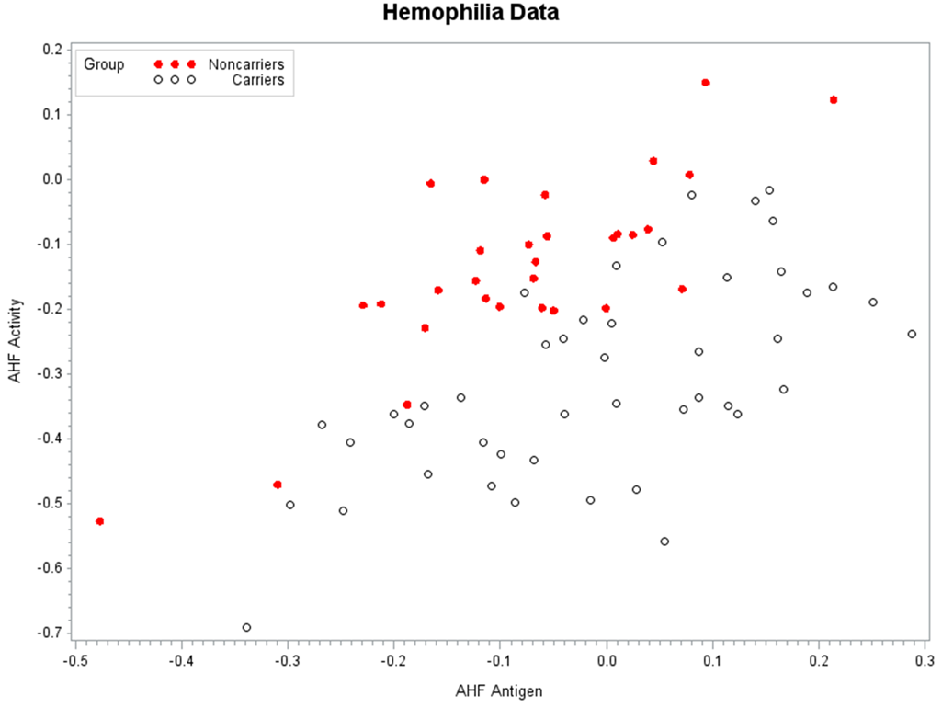
LDA Graphical presentation

Slide 27
LDA Graphical presentation

Slide 28
LDA (Graphical presentation)
Z1

Slide 30
With one discriminant variable and two groups
How do we make a decision which group a new observation is
With our new Z1, we calculate the average for carriers and the average for noncarriers
The midpoint between the two averages serves as the cutoff, in our example if the z1 value on our new observation is below that cutoff we will designate them noncarriers, if above, then carriers

Slide 31
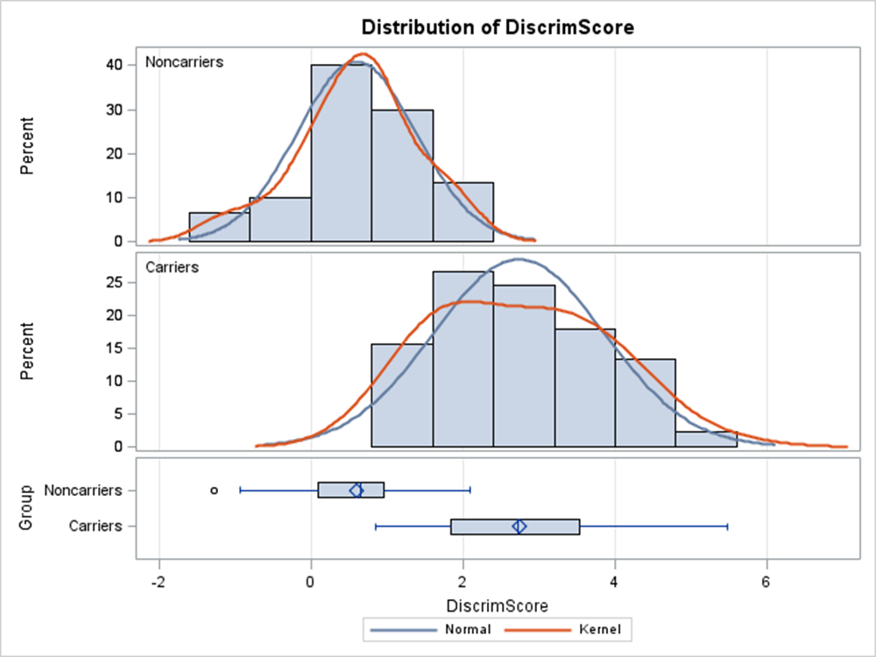
Boxplots of Z1 for carriers and noncarriers

Slide 32
Boxplots of Z1 for carriers and noncarriers

Slide 33
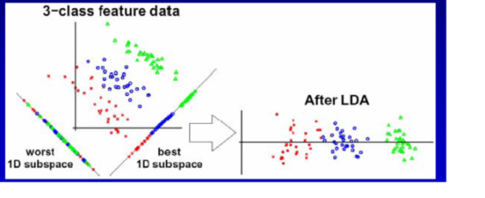
When Z1 is all you need
Suppose we have two response variables but instead of just two categories we wanted to be able to predict if an observation is one of 3 categories

Slide 34
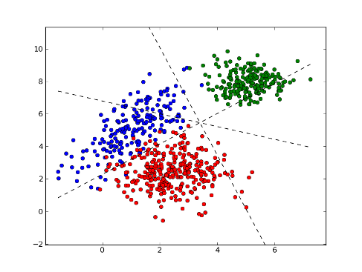
Sometimes you need more than Just one discriminant variable

Slide 35
Use of the discriminant functions
For 2 group problems, the discriminant function is all we need.
It can be used to create a classification rule to predict new observations
If we are dealing with a large number of variables, we reduce the variables to a single variable. The weights on the linear combination can be used to help provide some understanding as to what the key players (variables) are in classifying
For more than two groups
Can still use the discriminant functions and their weights to understand what variables are key in discriminating
For classifying, we can use our assumptions of normality and equal covariance matrix to partition the variable space into regions.
SAS provides a “discriminating/classfiying” function for each of the groups that can be used to classify an observation. It also can be used to assign a probability that a new observation is in each group. (Videos)

Slide 36
Partitioning the Variable space

Slide 37
General Idea
The discriminant scores are determined by the eigen values and eigenvectors of the Covariance matrices from the MANOVA model (between and within, H and E, model and residual)
The scores themselves attempt to maximize the separation between groups, while minimizing within groups
For 2 group classification. We can use the discriminant score to come up with a decision rule to classify a new observation.
For real world applications using SAS, regardless of how many groups there are we will let SAS determine the appropriate decisison rules and posterior probabilities for new observations that we want to classify

Slide 38
If I choose my prior probabilitys such that its much more likely that blue and red occur. The cutoff regions change to reflect that P(Red)=P(Blue)=.4 P(Green)=.2

Slide 39
RUNNING LDA in Practice (Classifying)
Assumptions are the same as MANOVA
We need to do our due diligence in assessing normality and equal covariance matrices as well as outliers just like MANOVA
Proc Discrim actually provides a statistical test for equal covariance matrices!!!
Assumptions are important here. If equal covariance is not valid, we need to go to Quadratic DA.
If many variables are non normal (skewed) we have other method alternatives like logistic regression.

Slide 40
Running LDA in PRACTICE
When assessing how well you classify on your training data set, use CROSSVALIDATE (leave one out) to not BIAS your error rates too much
With sample sizes big enough, of course run training and test sets
If your have prior knowledge and understanding of the study, use it with the prior probability statement.

Slide 41
Frequency table to See what we can possibly use as priors for test set
The FREQ Procedure
Group
Group | Frequency | Percent | Cumulative Frequency | Cumulative Percent
Noncarriers | 30 | 40.00 | 30 | 40.00
Carriers | 45 | 60.00 | 75 | 100.00

Slide 42
Running LDA on our example
proc discrim data=Hemophil pool=test crossvalidate canonical ncan=2 testdata=test testout=a list testlist;
class group;
var Activity Antigen;
priors "Carriers"=.6 "Noncarriers"=.4;
run;
Pool=True linear da Pool=F = Quadratic da
Pool=test test for equal covariance matrices across the groups, good to have for MANOVA.
Priors=prior knowledge probablities reflecting the frequencey of the categories
Testdata =new data we want to predict categories for
Testout = export test results to a new sas dataset
List and testlist provide probabilities for each category

Slide 43
Swimming in SAS Output (Main Components)
Class Level Information
Group | Variable Name | Frequency | Weight | Proportion | Prior Probability
Carriers | Carriers | 45 | 45.0000 | 0.600000 | 0.600000
Noncarriers | Noncarriers | 30 | 30.0000 | 0.400000 | 0.400000
The DISCRIM Procedure
Number of Observations Read | 75
Number of Observations Used | 75
Total Sample Size | 75 | DF Total | 74
Variables | 2 | DF Within Classes | 73
Classes | 2 | DF Between Classes | 1

Slide 44
Swimming in SAS (Main Components)
Discriminant/Classification function for Group
This is easily confused with the z variable earlier. Its not the same. Here we have a z-type variable for each group. So for a new observation we want to predict, we can use this as a decision rule
For a new activity and antigen value (0.2,.3)
Calculate Carriers value -4.48-26*0.2+18*.3
Calculate Noncarriers value -1.2-6.8*.2+1.27*.3
Which ever one is higher, we classify the new observation to that category
Linear Discriminant Function for Group
Variable | Label | Carriers | Noncarriers
Constant |  | -4.48101 | -1.32701
Activity | AHF Activity | -26.14277 | -6.82377
Antigen | AHF Antigen | 18.39440 | 1.27017

Slide 45
Classification summary How well we did (CROSS VALIDATION/ Not reSubstitution)
Number of Observations and Percent Classified
into Group
From Group | Carriers | Noncarriers | Total
Carriers | 38 | 7 | 45
 | 84.44 | 15.56 | 100
Noncarriers | 4 | 26 | 30
 | 13.33 | 86.67 | 100
Total | 42 | 33 | 75
 | 56 | 44 | 100
Priors | 0.6 | 0.4
Error Count Estimates for Group
 | Carriers | Noncarriers | Total
Rate | 0.1556 | 0.1333 | 0.1467
Priors | 0.6000 | 0.4000
Roughly 85% accuracy

Slide 46
Classification summary How well we did (CROSS VALIDATION/ Not reSubstitution)
Number of Observations and Percent Classified
into Group
From Group | Carriers | Noncarriers | Total
Carriers | 38 | 7 | 45
 | 84.44 | 15.56 | 100
Noncarriers | 4 | 26 | 30
 | 13.33 | 86.67 | 100
Total | 42 | 33 | 75
 | 56 | 44 | 100
Priors | 0.6 | 0.4
% Correct just by chance
.6(45) +.4(30) = 39
39/75=52%
Error Count Estimates for Group
 | Carriers | Noncarriers | Total
Rate | 0.1556 | 0.1333 | 0.1467
Priors | 0.6000 | 0.4000
Roughly 85% accuracy

Slide 47
Predicting new observations that were in TEST based off posterior Probabilities
Posterior Probability of Membership in Group
Obs | Classified into Group |  | Carriers | Noncarriers
1 | Noncarriers |  | 0.0621 | 0.9379
2 | Carriers |  | 0.6704 | 0.3296
3 | Carriers |  | 0.9335 | 0.0665

Slide 48
Additional helpful TaBLE when lots of variables are being analyze
This graph provides a way to assess which of the discriminating function provides
a better ability to discriminate, with 2 variables its not very informative but with many
It is much more helpful. Seen by adding the CANONICAL option.
 | Canonical Correlation | Eigenvalues of Inv(E)*H = CanRsq/(1-CanRsq) |  |  |  | Test of H0: The canonical correlations in the current row and all that follow are zero
 |  | Eigenvalue | Difference | Proportion | Cumulative | Likelihood Ratio | Approximate F Value | Num DF | Den DF | Pr > F
1 | 0.72 | 1.12 |  | 1.00 | 1.0 | 0.46 | 40.60 | 2 | 72 | <.0001

Slide 49
Next Week: Items To Focus On
Lecturer: Derek Blankenship
Topics: Principal Components Analysis (PCA) and Canonical Correlations Analysis (CCA)
Lecture Overview: A lot of material is given in the readings and videos. For class we will focus on the basics and practical approaches to PCA. As time permits, we will delve into advanced applications.
Suggest reading and viewing material in this order:
Text
17.1 to 17.4
***17.5.3 & 17.5.4 These sections (Multidimensional Scaling and Correspondence Analysis) are needed for the quiz. You will be presented study scenarios and will need to pick the appropriate analysis among PCA, CCA, Multidimensional Scaling and Correspondence Analysis.
17.6 Summary
Reading
“Statistical Learning: Principle Components and Partial Least Squares Regression” pgs 1-14
Videos
A lot of material is presented and well outlined. Watch the videos in order, but focus on the purpose and uses of PCA, SAS code, and interpreting results. Don’t let the mathematics and theory bog you down.
Additional Readings
For those interested, the remaining articles dig deeper into the math and theory of PCA and CCA.

Slide 50
Assignment
Read problem 17.16 and conduct the following analyses (ignore questions a-d in the textbook).
PCA
Run summary statistics and correlation analysis on variables: Fire, Theft, Age, Income, and Race
With only these variables (Fire, Theft, Age, Income, and Race) run PCA with and without the COV option using proc princomp.
How do you interpret the results of each analysis?
What are the differences between the two analyses?
Which analysis would you use and why?
Bonus: Using the proc you desire, run multiple regression analysis with “vol” as the outcome and the principle component variables as predictors.
How do you think Principle components could be used in “real world” settings?”

Slide 51
Agenda
PCA as standalone analysis proc princomp
vs
Data reduction for multiple regression
Canonical correlation as standalone proc cancorr
vs
Using within MANOVA and LDA

Slide 52
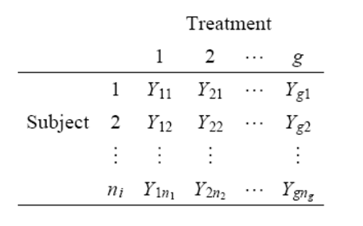
Let’s Take a StEp BACK: ANOVA!
GROUP
OBSERVATION

Slide 53
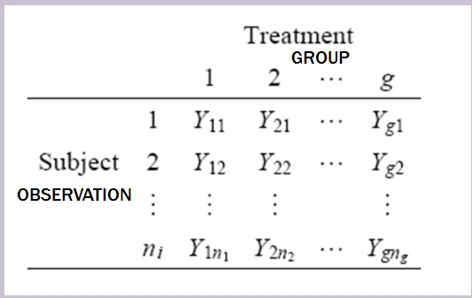
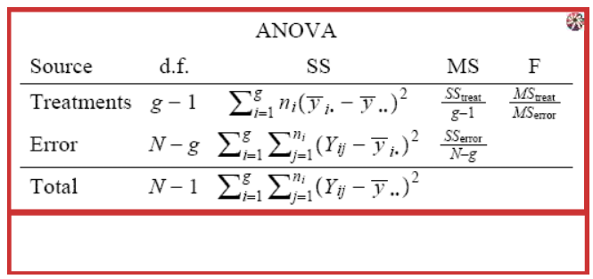
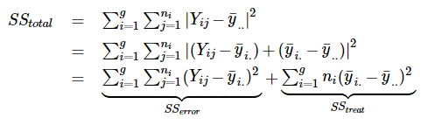
Let’s Take a StEp BACK: ANOVA!

Slide 54
ANOVA ASSUMPTIONS
1. The responses in each group come from normal distributions.
2. Each group’s distribution of responses have the same standard deviation.
3. Observations / responses are independent both within and between groups.

Slide 55
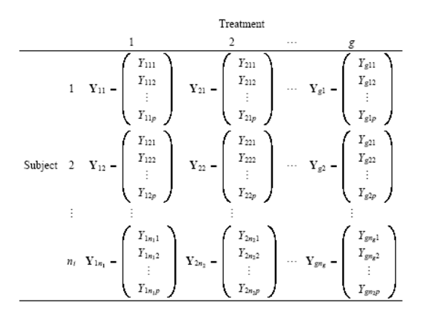
MANOVA: EXTENTION OF ANOVA
MANOVA
ANOVA
GROUP
OBS

Slide 56
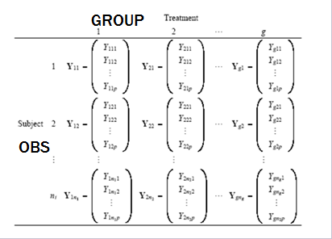
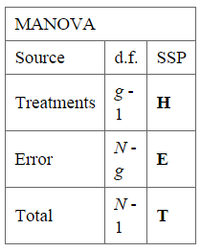
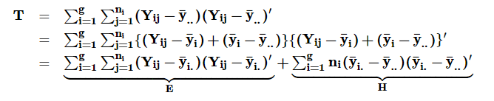
MANOVA: EXTENTION OF ANOVA

Slide 57
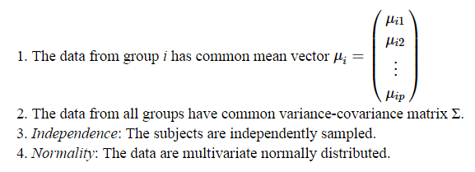
MANOVA ASSUMPTIONS

Slide 58
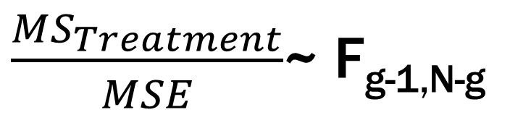
ANOVA: TEST STATISTIC
$\frac{{MS}_{Treatment}}{MSE}$~ F_{g-1,N-g}

Slide 59
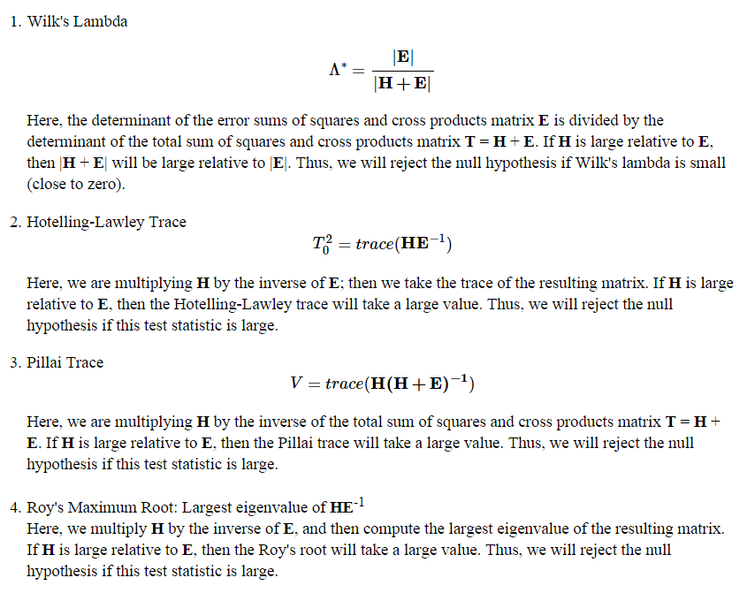
MANOVA: APPROXIMATING THE F-DISTRIBUTION
~ F_,_

Slide 60
MANOVA A NOTE ON ASSUMPTIONS
CHECK ASSUMPTIONS:
NORMALITY
VERY DIFFICULT TO CHECK Multi Variate Normal Assumption.
IN PRACTICE CHECK ALL BIVARIATE (PAIRWISE) NORMAL DISTRIBUTIONS

Slide 61
MANOVA ASSUMPTIONS: MVN
R Simulation
Looking for Elipses!
RUBUST FOR LARGE SAMPLE SIZES (CLT)!

Slide 62
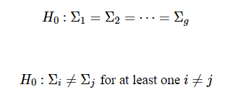
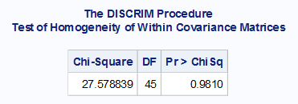

MANOVA ASSUMPTIONS: HoMOGENEITY EQUAL SSCP matriCES
LOOKING FOR EQUAL ELIPSES
If you can’t tell … similar to Brown Forsythe for ANOVA …we have Bartlett’s Test (proc descrim.)
MANOVA is not ROBUST TO THIS ASSUMPTION!!!! If not met, try an transformation.
H_{a}

Slide 63
WhY MANOVA!?
What does multivariate get you?
Its all about type-I error control and power
Type-I error: Probability(reject the Null when the Null is true) aka False Positive
Power: Probability(reject the Null when the Null is FALSE) aka reject when you should reject
Analyzing multiple response variables one at a time is another way of multiple testing, just like in our one variable analysis when we do different types of comparisons. We could do a single comparison but multiple times across different response variables.
The idea is that correlated data tend to yield similar results so when you commit a type-I error for variable 1 you are now setting yourself up for another type=I error for the correlated variable 2.
Also correlated variables are more consistent and its easier to identify scenarios that are not null and thus reject more often (increasing power)

Slide 64
Simple example
Suppose I had height (X1) and weight (X2) and I wanted to test if the mean height and weight was (68inches,150lbs)
Two options
One at a time testing
One sample t-test for height (X1)
One sample t-test for weight (X2)
Multivariate Analysis
Conduct a joint hypothesis that takes into account they are correlated

Slide 65
Graphical Difference One at a time vs Jointly
One at a time tests/confidence intervals can in a 2 dimensional graph can be viewed as a box

Slide 66
Graphical Difference One at a time vs Jointly
Multivariate tests/confidence intervals can be thought of as an ellipse

Slide 67
Example scenario for greater power
Suppose our null hypothesis for the mean of height and weight is given by the yellow dot
One at a time confidence intervals say for both variables we will not reject the null hypothesis
Joint confidence ellipse (taking into account correlation) says the hypothesized value is outside of the confidence ellipse indicating that we should reject the null.

Slide 68
Example scenario for controlling type I error
Suppose are null hypothesis for the mean of height and weight is given by the yellow dot
One at a time confidence intervals say for both variables we will reject the null
Joint confidence ellipse (taking into account correlation) says the hypothesized value is inside of the confidence ellipse indicating that we should fail to reject

Slide 69
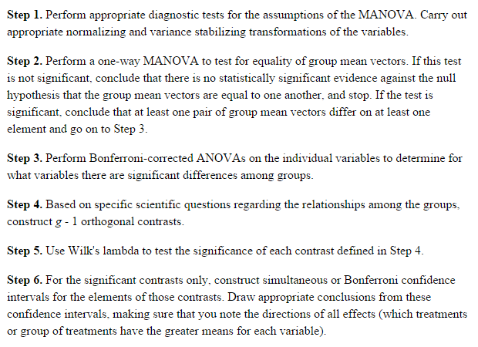
EXAMPLE: STEPS: POTTERY

Slide 70
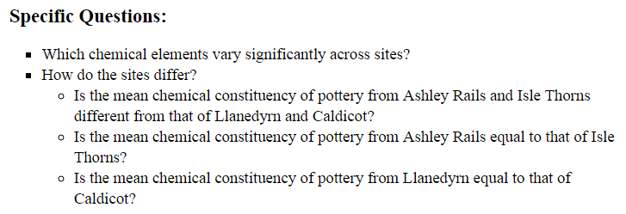
POTTERY: CONTRASTS

